Slide 1


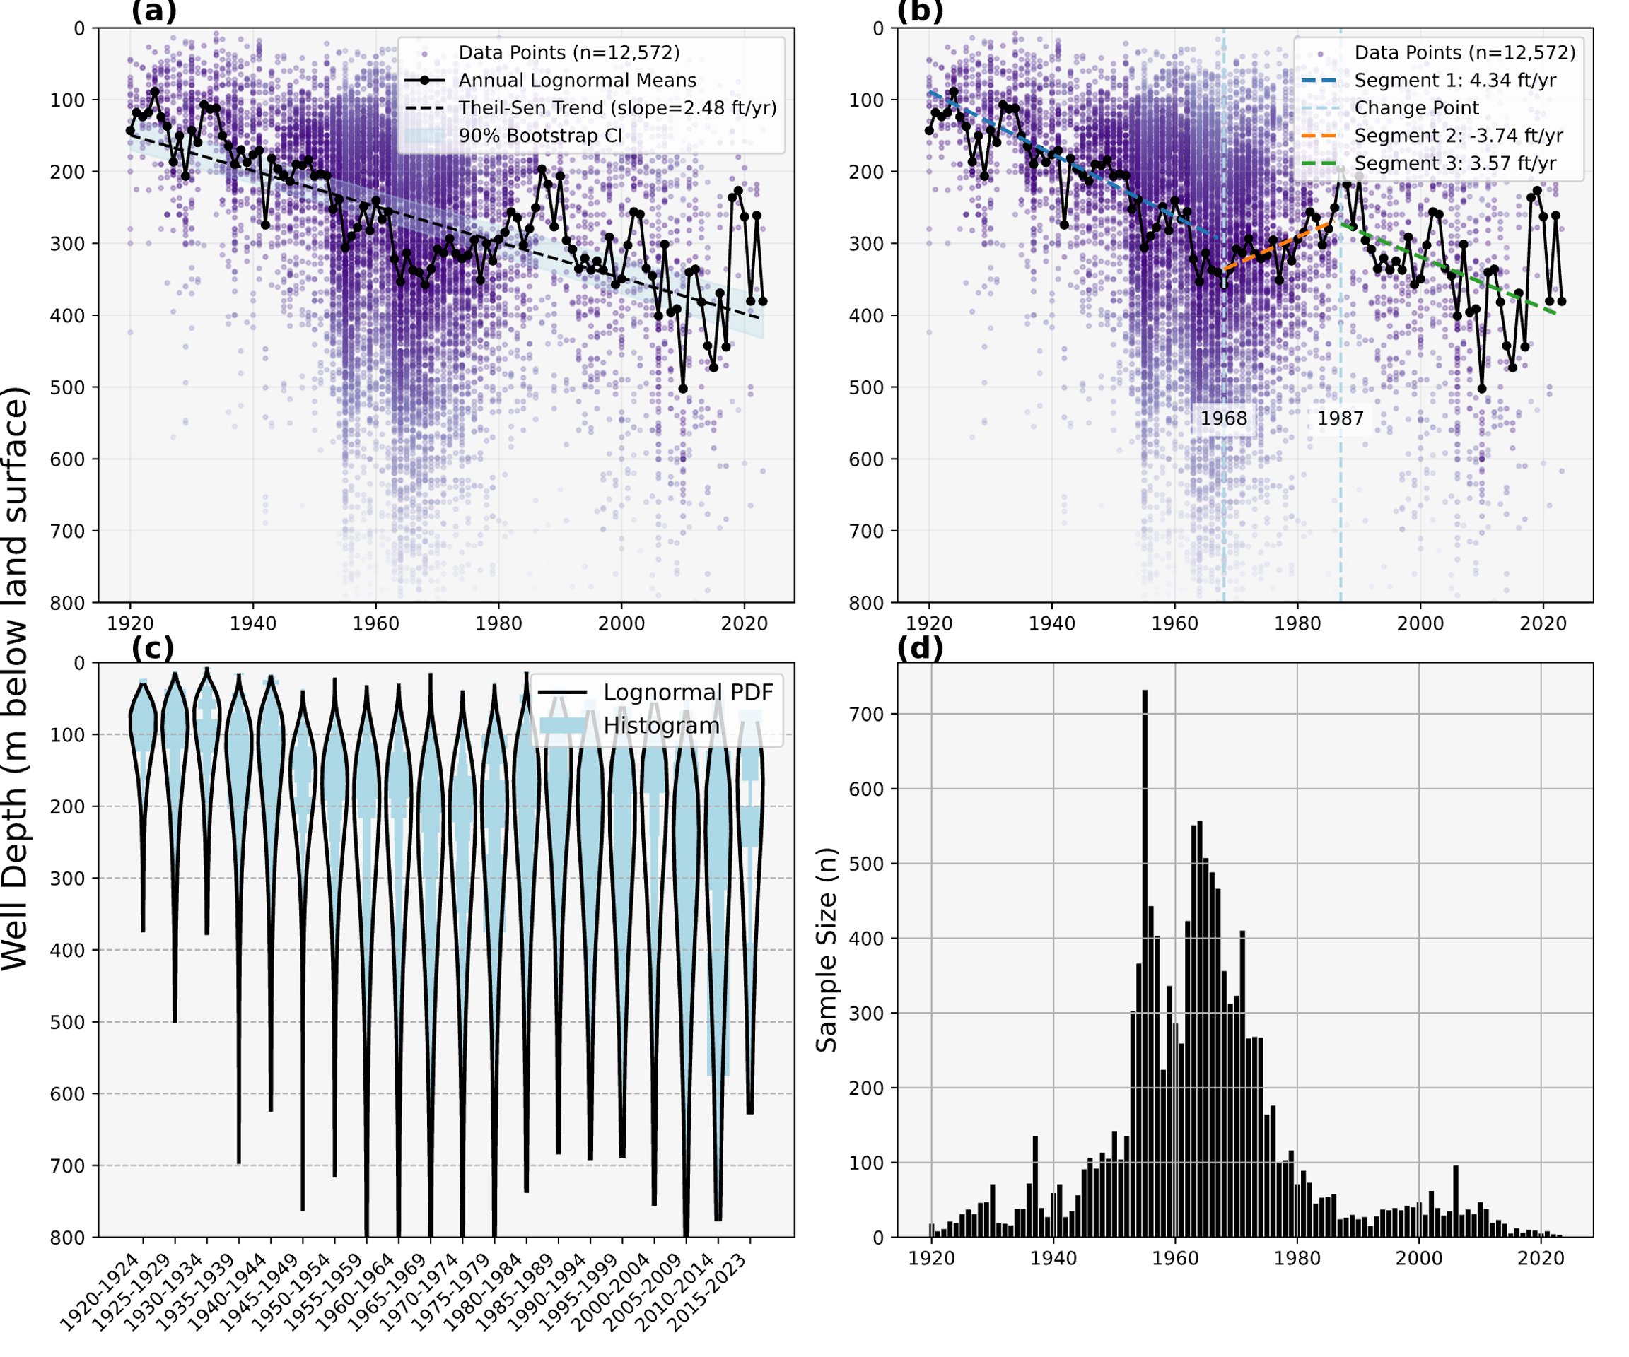
Analysis of Well Depths from 1920-2023 for the Major Aquifers of Texas H. Finley Davis^{1,*} and M. Bayani Cardenas¹ Add author’s affiliations here
Introduction
Groundwater acts as a buffer against climate and hydrologic variability and supplies over half of Texas’ annual freshwater use
Regions in Texas are global hotspots for groundwater depletion due to over-extraction
Declining groundwater resources threaten municipal supplies, agricultural production, and ecosystem health
The goal of this study is to analyze long-term well depth trends across Texas to better understand how access to groundwater resources may be changing
IMPORTANCE
Results and Interpretations go here
-Short/snappy text is best
-Bullet points are better than paragraphs
-Large graphs/plots/images are good here
Results and Interpretations go here
- Short/snappy text is best
-Bullet points are better than paragraphs
-Large graphs/plots/images are good here
-A good interpretive sketch or
schematic can be very useful here
Results Summary or
Discussion points goes here
- Summarize what people should know
- WHAT ARE THE 3-5 MAIN TAKE AWAY POINTS?
Add background information/
methods/geological setting here
- Short/snappy text is best
- Bullet points are better than paragraphs
- Make sure you give people background on what you’re doing
Future/Ongoing Work goes here
- What are you still doing?
- Acknowledgements or key
references can go here
Use a “non Serif” font (like Myriad Pro, Helvetica, Ariel, Calibri, etc.)
Make sure your text/Figures are readable (e.g., this is 48pt font, bold)
Be sure to check alignment of text/objects,
spelling, and colors before printing!
Color and shapes are your friend for drawing people’s attention to the important stuff.
This isn’t a white paper! That said, no one likes a cacophony of color!

